Slide 1
What is Quality?
“ The quality of a product or service is a customer’s perception of the degree to which the product or service meets his or her expectations.”
According to Dr. W.R.Spriegel , “ The quality of a product may be defined as the sum of a number of related characteristics such as shape, dimension, composition, strength, workmanship, adjustment, finish and color.”

Slide 2
What is Quality Control?
"Quality control may be defined as that industrial management technique or group of techniques by means of which products of uniform acceptable quality are manufactured."
Alford and Beatty
"Quality control refers to the systematic control of those variables encountered in a manufacturing process which affect the excellence of the end product, Such variables result from the application of materials, men, machines and manufacturing conditions,"
Bethel, Atwater and Stackman

Slide 3
The Dimensions of quality
Performance: Primary operating characteristics
Features : Secondary operating characteristics
Time : Time of service, time waiting in line
Reliability : Extent of failure free operation
Durability : Amount of use until replacement is preferable to repair.
Uniformity : Low variation among the repeated outcomes of a process.
Consistency : Match with documentation, advertising, deadlines.
Serviceability : Resolution of problems
Aesthetics
Personal interface
Harmlessness

Slide 4
Four dimensions of quality of a good or service
1. Quality of design
- determined before the product is produced
- Uses a cross-functional team to translate the wishes of the customer into specifications
- Concurrent design through the Quality Function Deployment process.
2. Quality of Conformance-
producing a product to meet the specifications independent of the quality of design.

Slide 5
3. Meets the abilities-
-Availability (Continuity of service to the customers)
- Reliability (Length of time that a product can be used before it fails – MTBF)
- Maintainability (Restoration of the product or service once it has failed-MTTR)
4. Field Service
– Warranty and repair or replacement of the product after it has been sold.
– Also called customer service, sales service, or just service
– Dimensions
• Promptness
• Competence
• Integrity

Slide 6
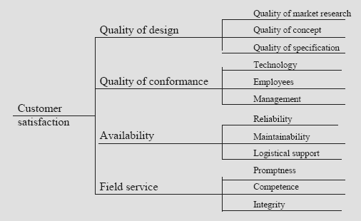

Slide 7
Seven Problem Solving QC Tools
Cause-and-Effect Diagrams
Flowcharts
Checklists
Control Charts
Scatter Diagrams
Pareto Analysis
Histograms

Slide 8
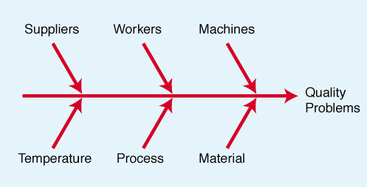
Cause-and-Effect Diagrams
Developed by Ishikawa in 1943
Called Fishbone Diagram or Ishikawa diagram
Explore possible root causes of a problem
If process is stable, this diagram helps to decide which causes to investigate for process investigation.

Slide 9
Flowcharts
Used to document the sequence of events in a process.
A detailed flowchart can identify bottlenecks, redundant steps, non-value added activities.
Has purchase order for payment received
No
Wait for purchase order
Order Received
Yes
Can order quantity be met from stock?
No
Produce as per demand
Yes
Check due date & lead time & set shipment date
Package Product
Ship product
Received by customer
Flow chart for incoming order processing

Slide 10
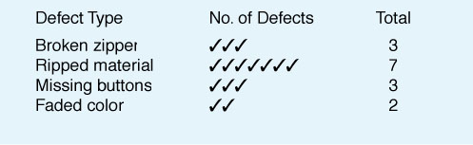
Checklist
It facilitates systematic record keeping or data collection
Observations are recorded as they happen, which reveals pattern or trends.
Simple data check-off sheet designed to identify type of quality problems at each work station; per shift, per machine, per operator

Slide 11
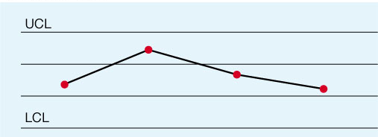
Control Charts
Used to monitor & control a process on an ongoing basis.
Plots a selected quality characteristics as a function of sample number.
Distinguish special causes of variation from common causes of variation.
Centre line represents the average value of characteristics being plotted. The UCL and LCL are calculated limits used to show when process is in or out of control
Quality Characteristics
CL
Sample no

Slide 12
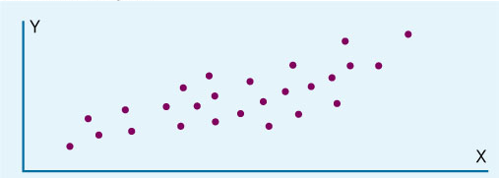
Scatter Diagrams
A graph that shows how two variables are related to one another
Often used a s follow-ups to a cause & effect analysis
Sales
Advertisement

Slide 13
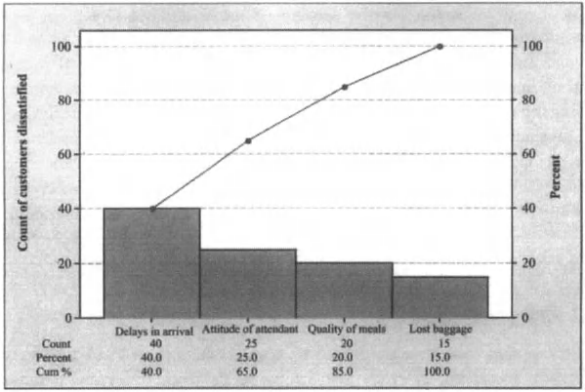
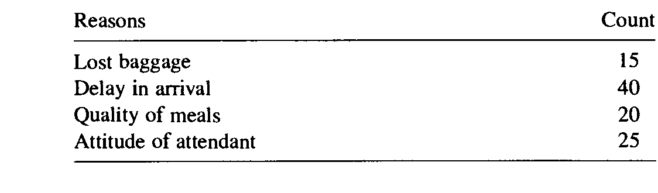
Pareto Analysis
Identify the critical areas that deserves immediate action.
Technique that displays the degree of importance for each element
Named after the 19th century Italian economist Alfredo Pareto.
Often called the 80-20 Rule (Vital few and trivial many)
Principle is that quality problems are the result of only a few problems e.g. 80% of the problems caused by 20% of causes

Slide 14
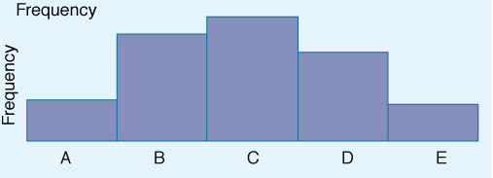
Histograms
Displays large amount of data that are difficult to interpret
Histogram reveals whether the process is centered around a target value, degree of variation in the data and whether data meet specification.
Help in identifying process capability relative to customer requirements
A chart that shows the frequency distribution of observed values of a variable like service time at a bank drive-up window.

Slide 15
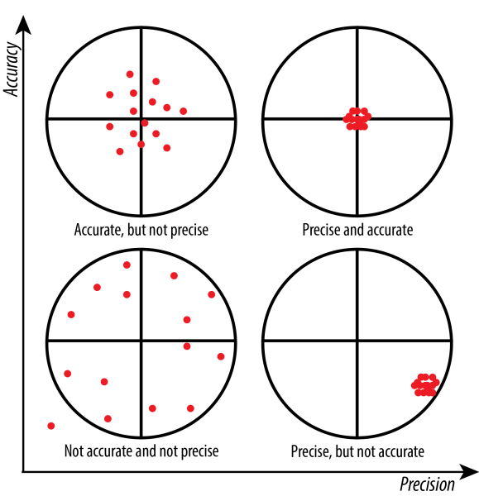
Accuracy Vs. Precision
Accuracy refers to how close measurements are to the "true" value. It describes the difference between the measurement and the part’s actual value.
precision refers to how close measurements are to each other. It describes the variation you see when you measure the same part repeatedly with the same device.

Slide 16
Sources of Variation
Variation exists in all processes.
Variation can be categorized as either;
Common or chance or Random causes of variation, or
Inherent to the process
Unavoidable
As per Deming 85% of problems are due to common causes
Vibration in machine, fluctuation in working conditions
Assignable causes of variation
Causes can be identified and eliminated
wrong tool, improper raw material, incorrect procedure

Slide 17
Quality Characteristics:
Variables : Quality characteristics whose numerical values can be obtained.
Length, width, etc
Attributes: Quality characteristics which can’t be measured on numerical scale. It can be represented as no. of nonconformities in a unit.

Slide 18
Control Charts:
Graphical tool used for monitoring the activity of an ongoing process.
Also known as Shewhart control charts.
Value of quality characteristics plotted along vertical axis whereas horizontal axis represents the sample.
Consists of three lines
Centre line (CL) represents average value of quality characteristics being plotted.
Upper control limit (UCL) & Lower control limit (LCL) are used to make decision regarding the process.
Types of Control Charts :
Control chart for variables are used to monitor characteristics that can be measured, e.g. length, weight, diameter, time
Control charts for attributes are used to monitor characteristics that have discrete values and can be counted, e.g. % defective, number of flaws in a shirt, number of broken eggs in a box .

Slide 19
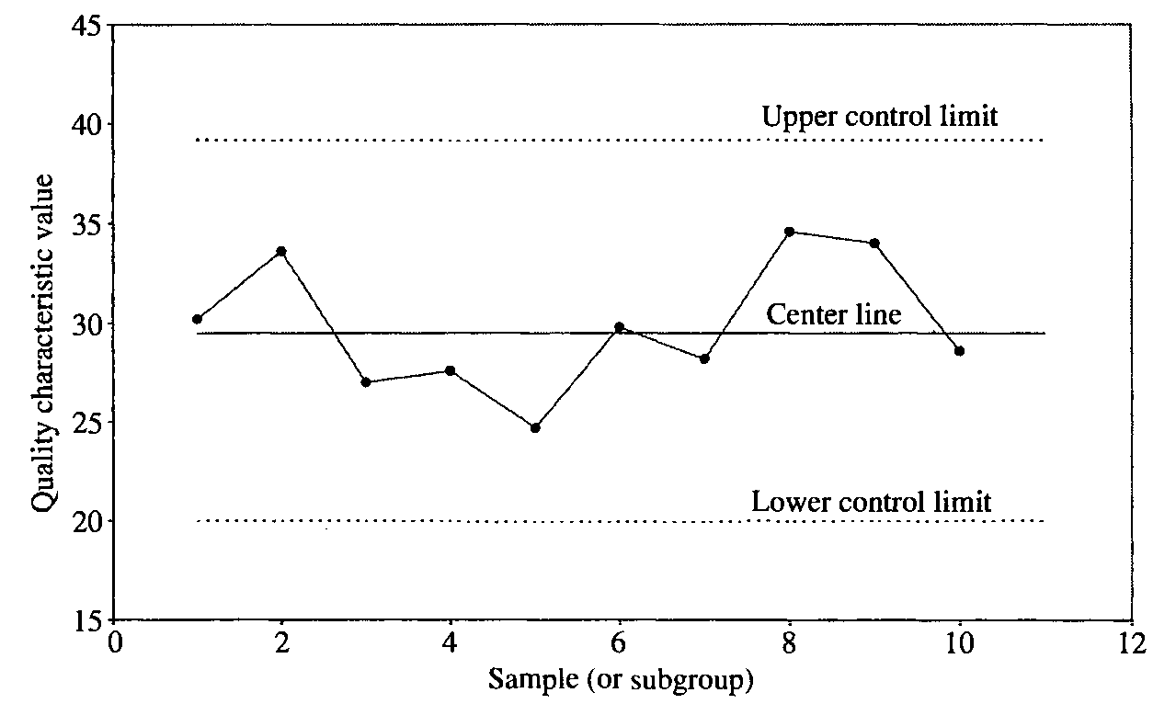
Control Charts:

Slide 20
Control Charts (Advantages):
When to take corrective action
Type of remedial action necessary
When to leave a process alone
Process capability.
Possible means of quality improvement

Slide 21
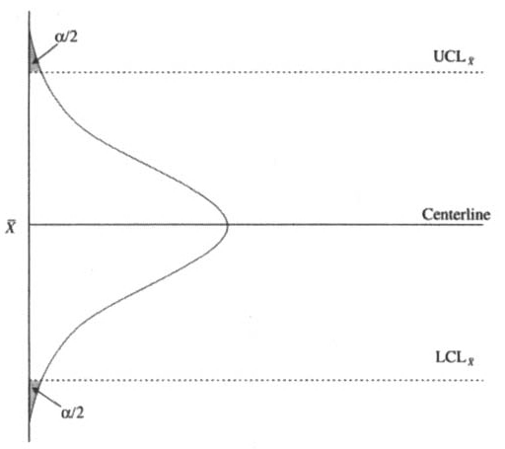
Errors in Control Charts :
Type I errors result from inferring that a process is out of control when it is actually in control. The probability of a type I error is denoted by α.

Slide 22
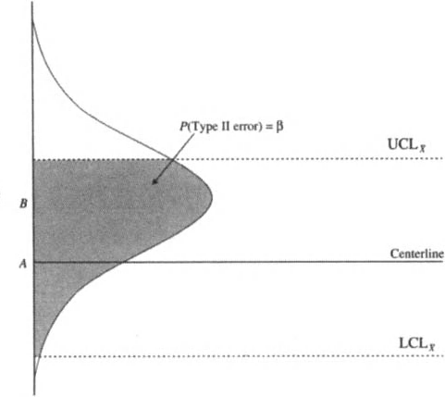
Errors in Control Charts :
Type II errors result from inferring that a process is in control when it is really out of control. If no observations fall outside the control limits, we conclude that the process is in control.

Slide 23
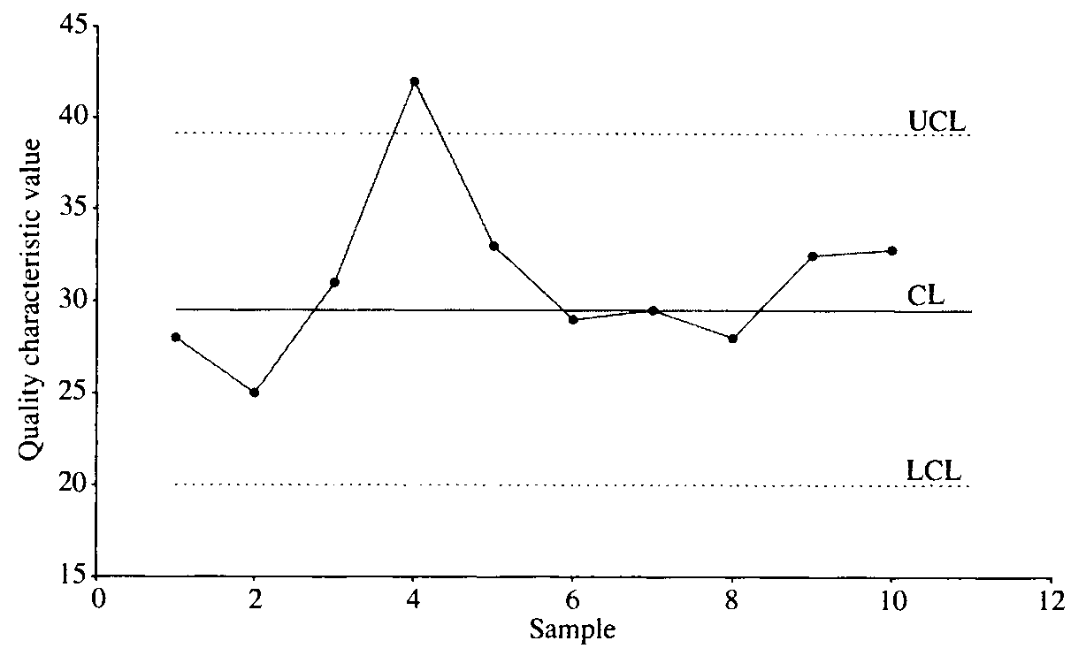
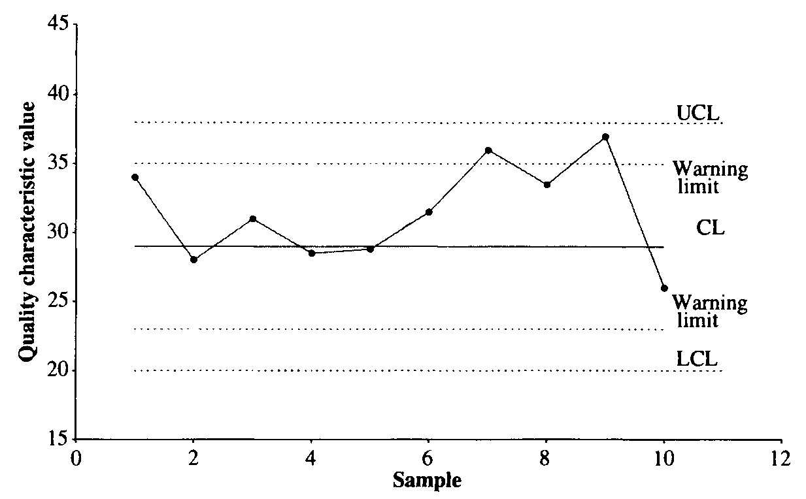
Rules for Identifying an Out-of-Control Process
Rule 1 A process is assumed to be out of control if a single point plots outside the control limits.
Rule 2 A process is assumed to be out of control if two out of three consecutive points fall outside the 2 σ warning limits on the same side of the centerline.

Slide 24
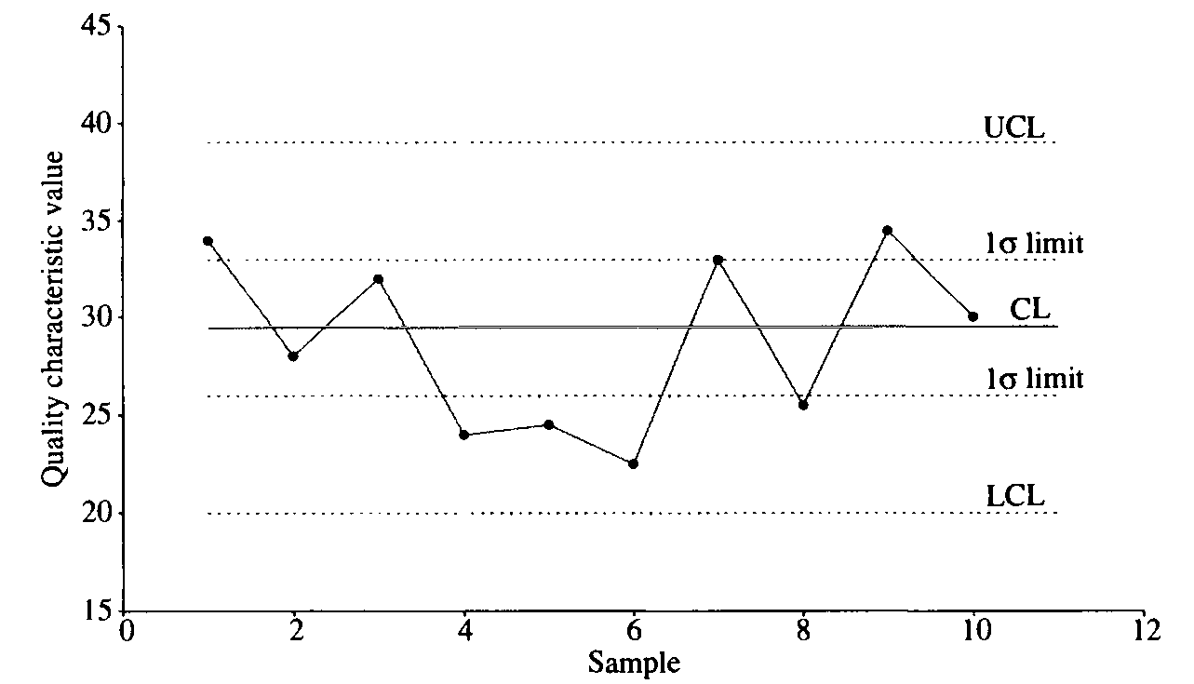
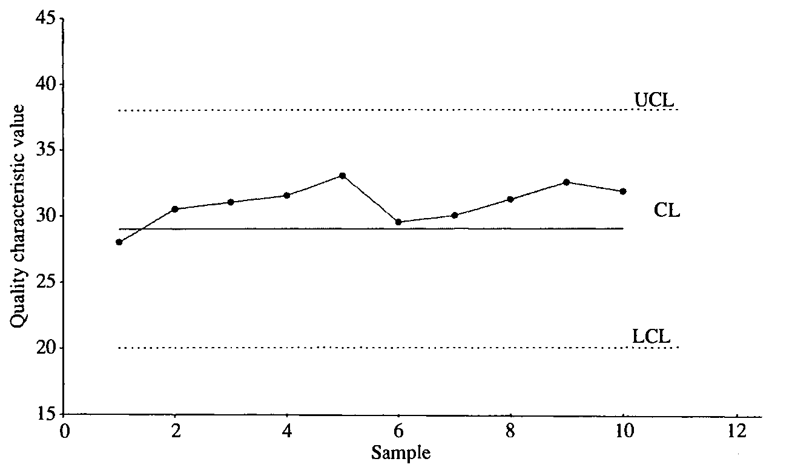
Rules for Identifying an Out-of-Control Process
Rule 3 A process is assumed to be out of control if four out of five consecutive points fall beyond the 1σ limit on the same side of the centerline.
Rule 4 A process is assumed to be out of control if nine or more consecutive points fall to one side of the centerline

Slide 25
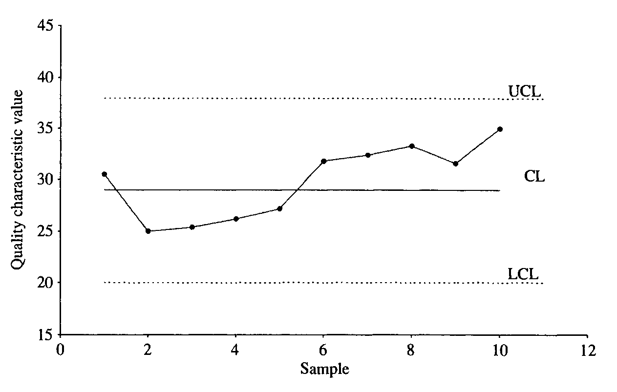
Rules for Identifying an Out-of-Control Process
Rule 5 A process is assumed to be out of control if there is a run of six or more consecutive points steadily increasing or decreasing.

Slide 26
Control Charts for Variables
Variables generate data that can be measured.
Mean control charts
Used to monitor the central tendency of a process
X bar charts
Range control charts
Used to monitor the process dispersion
R charts

Slide 27
Non conforming- Defective
Non conformities- defects

Slide 28
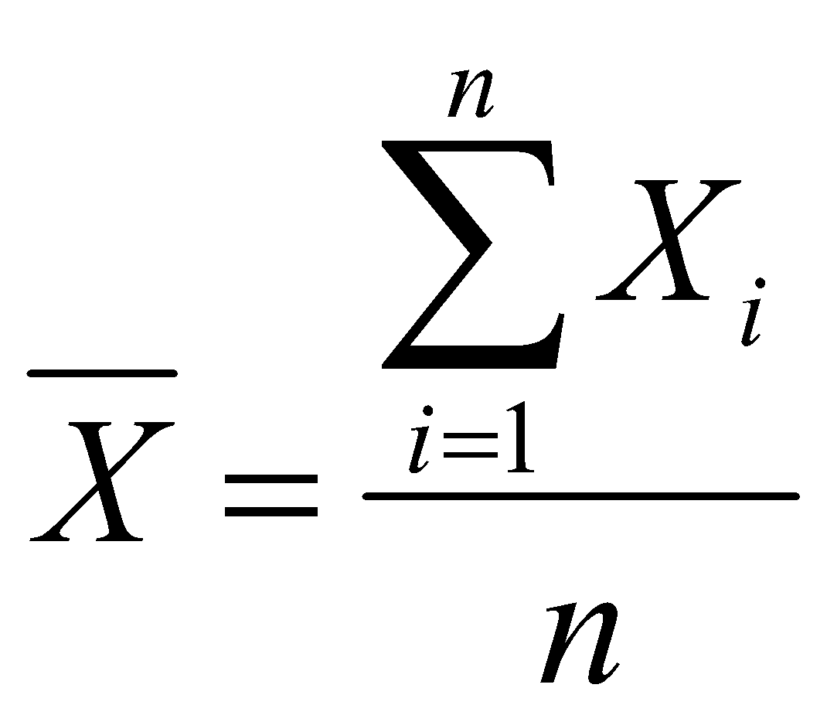

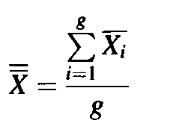
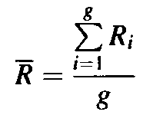
Steps of development of charts
Step 1: Using a preselected sampling scheme and sample size, record on the appropriate
forms, measurements of the quality characteristic selected.
Step 2: For each sample, calculate the sample mean and range using the following
formulas:
X̅ is the sample mean =
Sample range =
where X_{i} represents the ith observation, n is the sample size, X_{max} is the largest observation, and Xmin is the smallest observation.
Step 3: Obtain and draw the centerline and the trial control limits for each chart. For the
X-chart, the centerline X is given by
where g represents the number of samples.
For the R-chart, the centerline R is found from

Slide 29

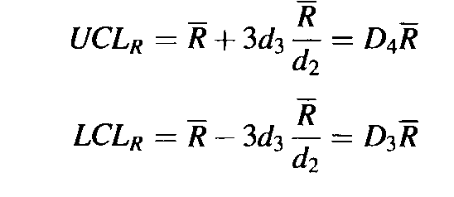
Steps of development of charts
The control limits for an X-chart are therefore estimated as
The control limits for the R-chart are estimated as
Step 4: Plot the values of the range on the control chart for range, with the centerline and the control limits drawn. Plot the values of the mean on the control chart for mean, with the centerline and the control limits drawn.
Step 5: Delete the out-of-control point(s) for which remedial actions have been taken to
remove special causes and use the remaining samples to determine the revised centerline and control limits for the X- and R-charts.
These limits are known as the revised control limits.
Step 6: Implement the control charts.

Slide 30
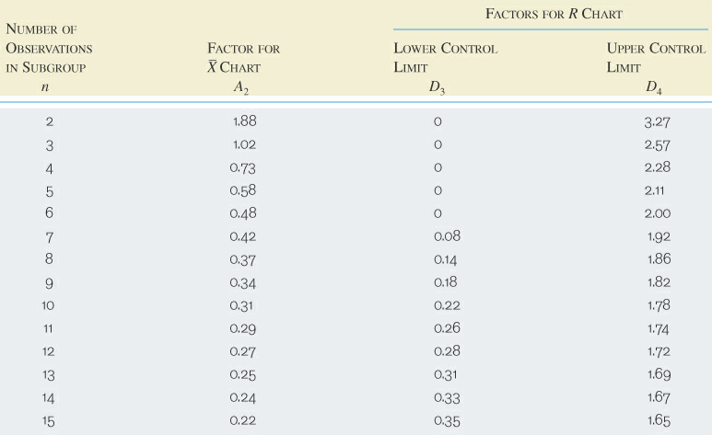
Sampling by Variable (Table 1)

Slide 31
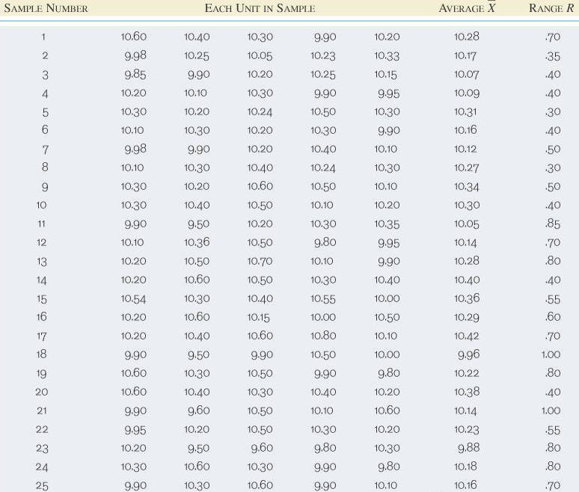
Sampling by Variable Example
You collect the following data from a process at your company. Draw the X and R charts for the process.

Slide 32
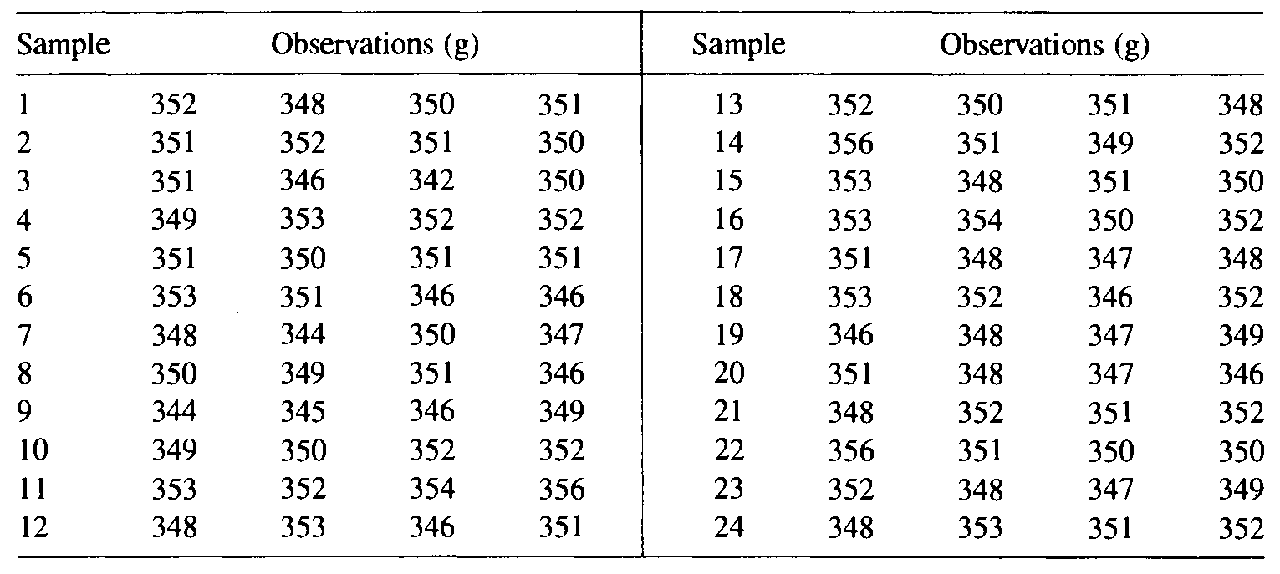
(a) Find the trial control limits for the X- and R-charts.
(b) Assuming special causes for out-of-control points, find the revised control limits.

Slide 33
Control Charts for Attributes
Nonconformity (defect) – A quality characteristic that does not meet specification.
Nonconforming (defective) – A product having one or more nonconformities and is unable to function as required.
Types of control chart for attributes:
Proportion of nonconforming items (p-chart)
No. of nonconforming items (np-chart)
Chart for total no of nonconformities (c-chart)
Chart for nonconformities per unit (u-chart)

Slide 34
Attribute Chart vs variable Chart
Attribute charts require larger sample sizes than variable charts.
Attribute information indicates whether a certain quality characteristic is within specification limits. It does not state the degree to which specifications are met or not met.
A variable chart can indicate an upcoming out-of control condition even though items are not yet nonconforming.
Attributes are encountered at all levels of an organization: the company, plant, depart_x0002_ment, work center, and machine (or operator) level whereas Variable charts are typically used at the lowest level, the machine level.
A control chart for attributes can provide overall quality information at a fraction of the cost.

Slide 35
Advantages and Disadvantages of attribute chart
A disadvantage of control charts for variables and attributes is that they only use data from the most recent measurement to draw conclusions about the process. This makes it quite insensitive to shifts on the order of 1.5 standard deviations or less.
Some advantages of using attribute control charts are as follows. (i)Attribute control charts could monitor more than one quality characteristic simultaneously. (ii)Attribute control charts need less cost and time for inspection than variable control charts.

Slide 36
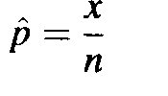
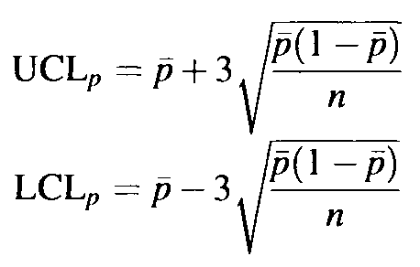
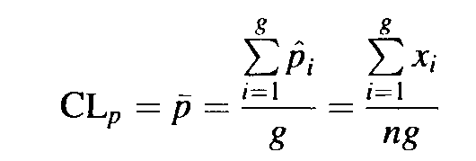
Chart for Proportion of nonconforming (p-chart)
Based on binomial distribution
Proportion nonconforming is defined as
where x is the number of nonconforming items in the sample and n represents the sample size.
Construction of p-chart:
Step 1: Determine the sample size and the sampling interval.
Step 2: Obtain the data, and record on an appropriate form.
Step 3: Calculate the centerline and the trial control limits
where g represents the number of samples
Step 4: Calculate the revised control limits
Step 5: Implement the chart

Slide 37
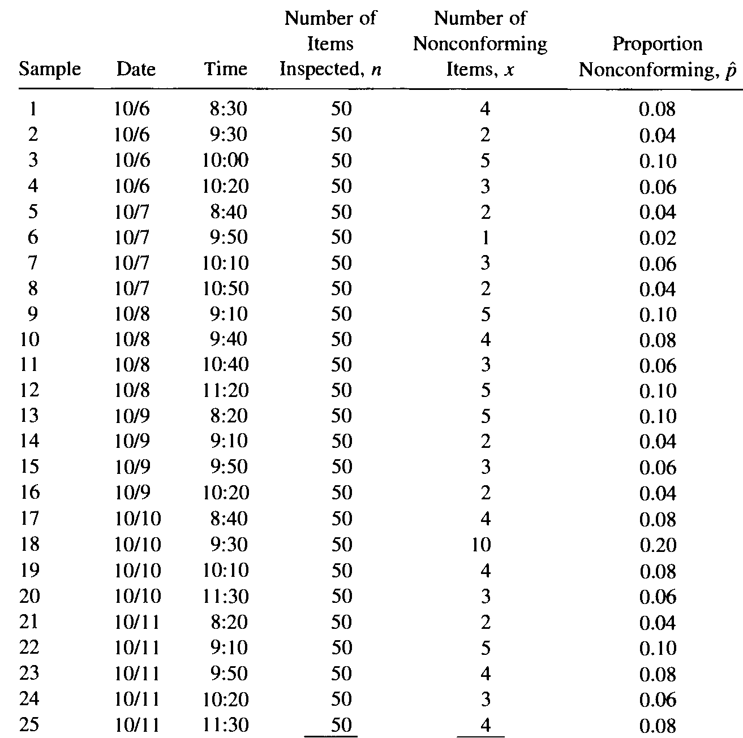
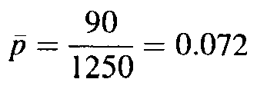
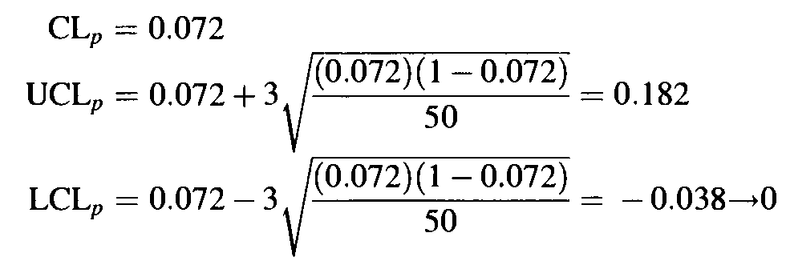
Twenty-five samples of size 50 are chosen from a plastic-injection molding machine producing small containers. The number of nonconforming containers for each sample is shown in Table, as is the proportion nonconforming for each sample
1250
90

Slide 40
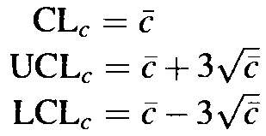
Chart for no. of nonconformities (c-chart)
Based on Poisson distribution
Construction of c-chart:
Step 1: Determine the sample size and the sampling interval.
Step 2: Obtain the data, and record on an appropriate form.
Step 3: Calculate the centerline and the trial control limits
Step 4: Calculate the revised control limits
Step 5: Implement the chart

Slide 41
Problem-2
Management has decided to set a standard of 3% for the proportion of nonconforming test tubes produced in a plant. Data collected from 20 samples ofsize 100 are shown in Table 8-3, as is the proportion of nonconforming test tubes for each sample. The centerline and control limits, based on the specified standard, are found to be

Slide 43
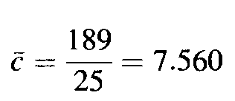
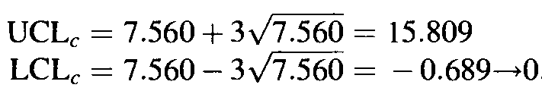
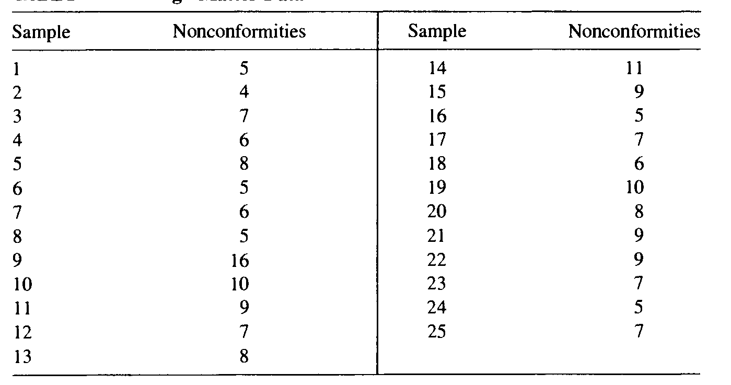
Chart for no. of nonconformities (c-chart)

Slide 44
Problem -3
Samples of fabric from a textile mill, each 100 m2 are selected, and the number of occurrences of foreign matter is recorded. Data for 25 samples are shown in Table 8-9. Construct a c-chart for the number of nonconformities.

